Slide 1
Project on Paleoclimate Temperature Backcasting
Shubhamoy Paul
Reg. No: 21414170024
Roll Number: 21414024
CRN: STAT024
Session: 2021-2023
Department of Statistics Presidency University, Kolkata

Slide 2
Introduction
Recent studies show that most statisticians are busy predicting the future temperature, which is obviously most important for us. But In understanding the nature of the climate, the past temperature is as important as the present or future temperature. In this project, past temperature has played an important role.

Slide 3
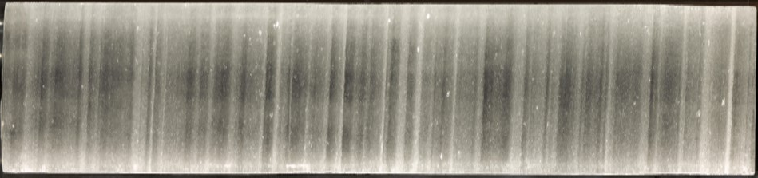
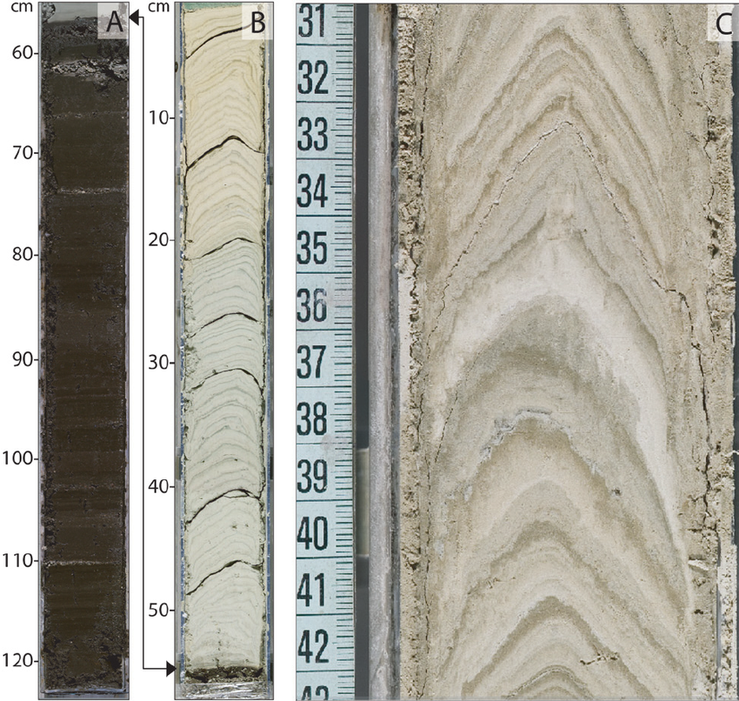
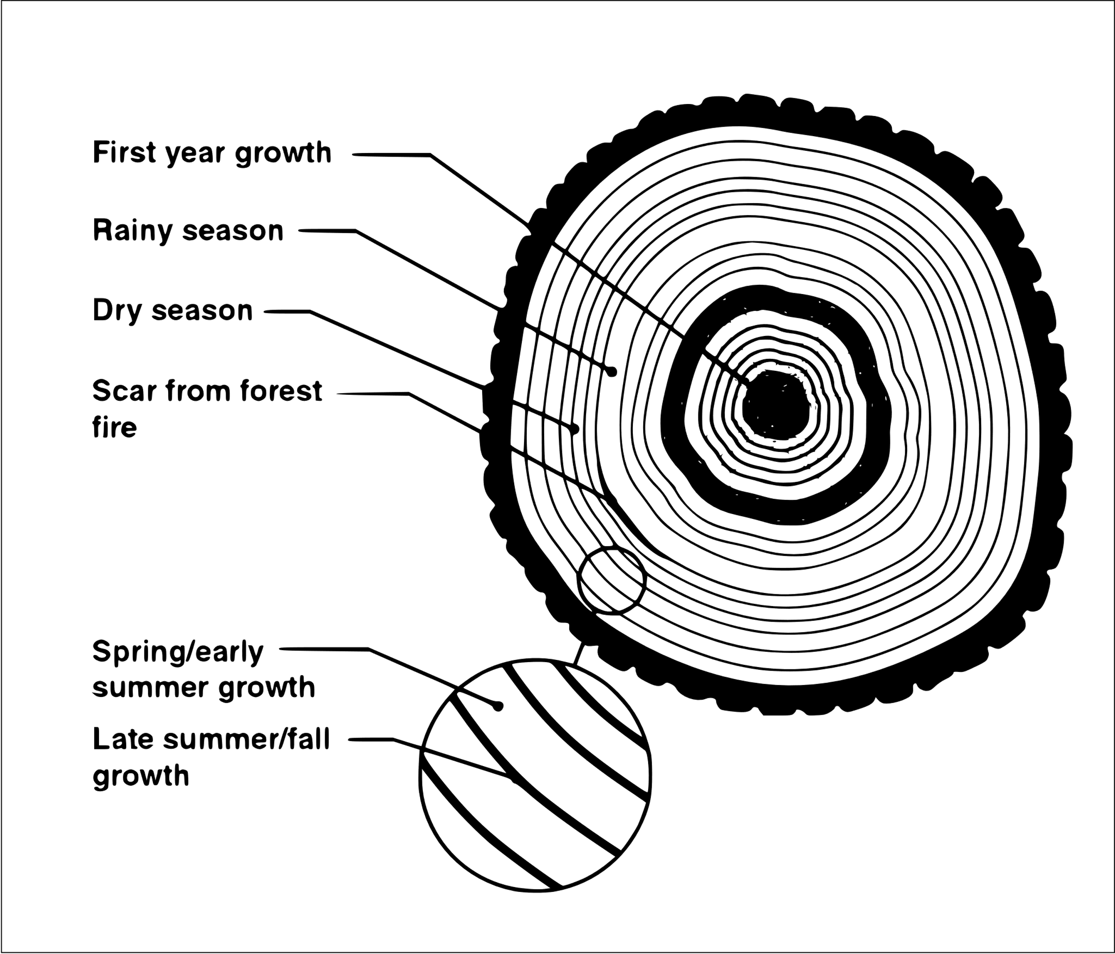
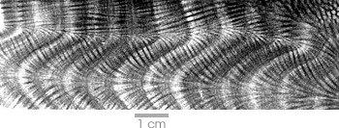
Exploring Paleoclimate Data
There are also many proxies to collect paleoclimate data
Proxies include ice cores, sediment cores, tree rings, historical records, and coral reefs.
Image1: Ice Cores
Image3: Tree Rings
Image4: Coral Reefs
Image2: Sediment Cores

Slide 4

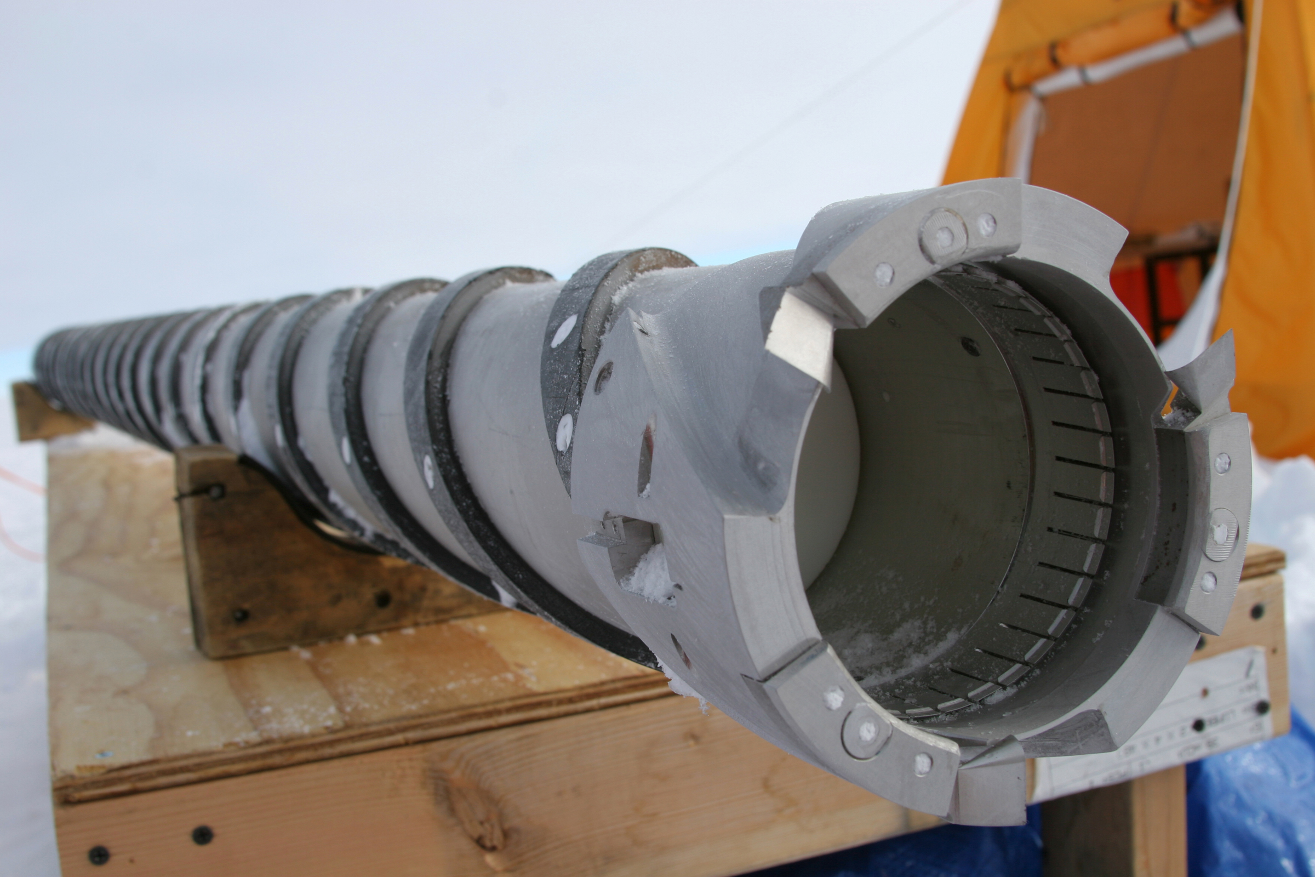
Ice Cores
Image5: Ice driller machines
I choose Ice-core proxy among all of these. because
Provide a long-term perspective on climate variability
Layers in ice cores can be accurately dated using various methods
Ice cores contain information about past climate conditions, including atmospheric composition, temperature, etc.

Slide 5
Data Descriptions
Data published by a Kobashi scientific research paper.
Paper approved by NCEI(National Centers of Environmental Information)
Temperature of air has high and low ranges
Data taken from GISP2 project
Data collected from Greenland Ice Sheet
Research paper published on May 3, 2017

Slide 6
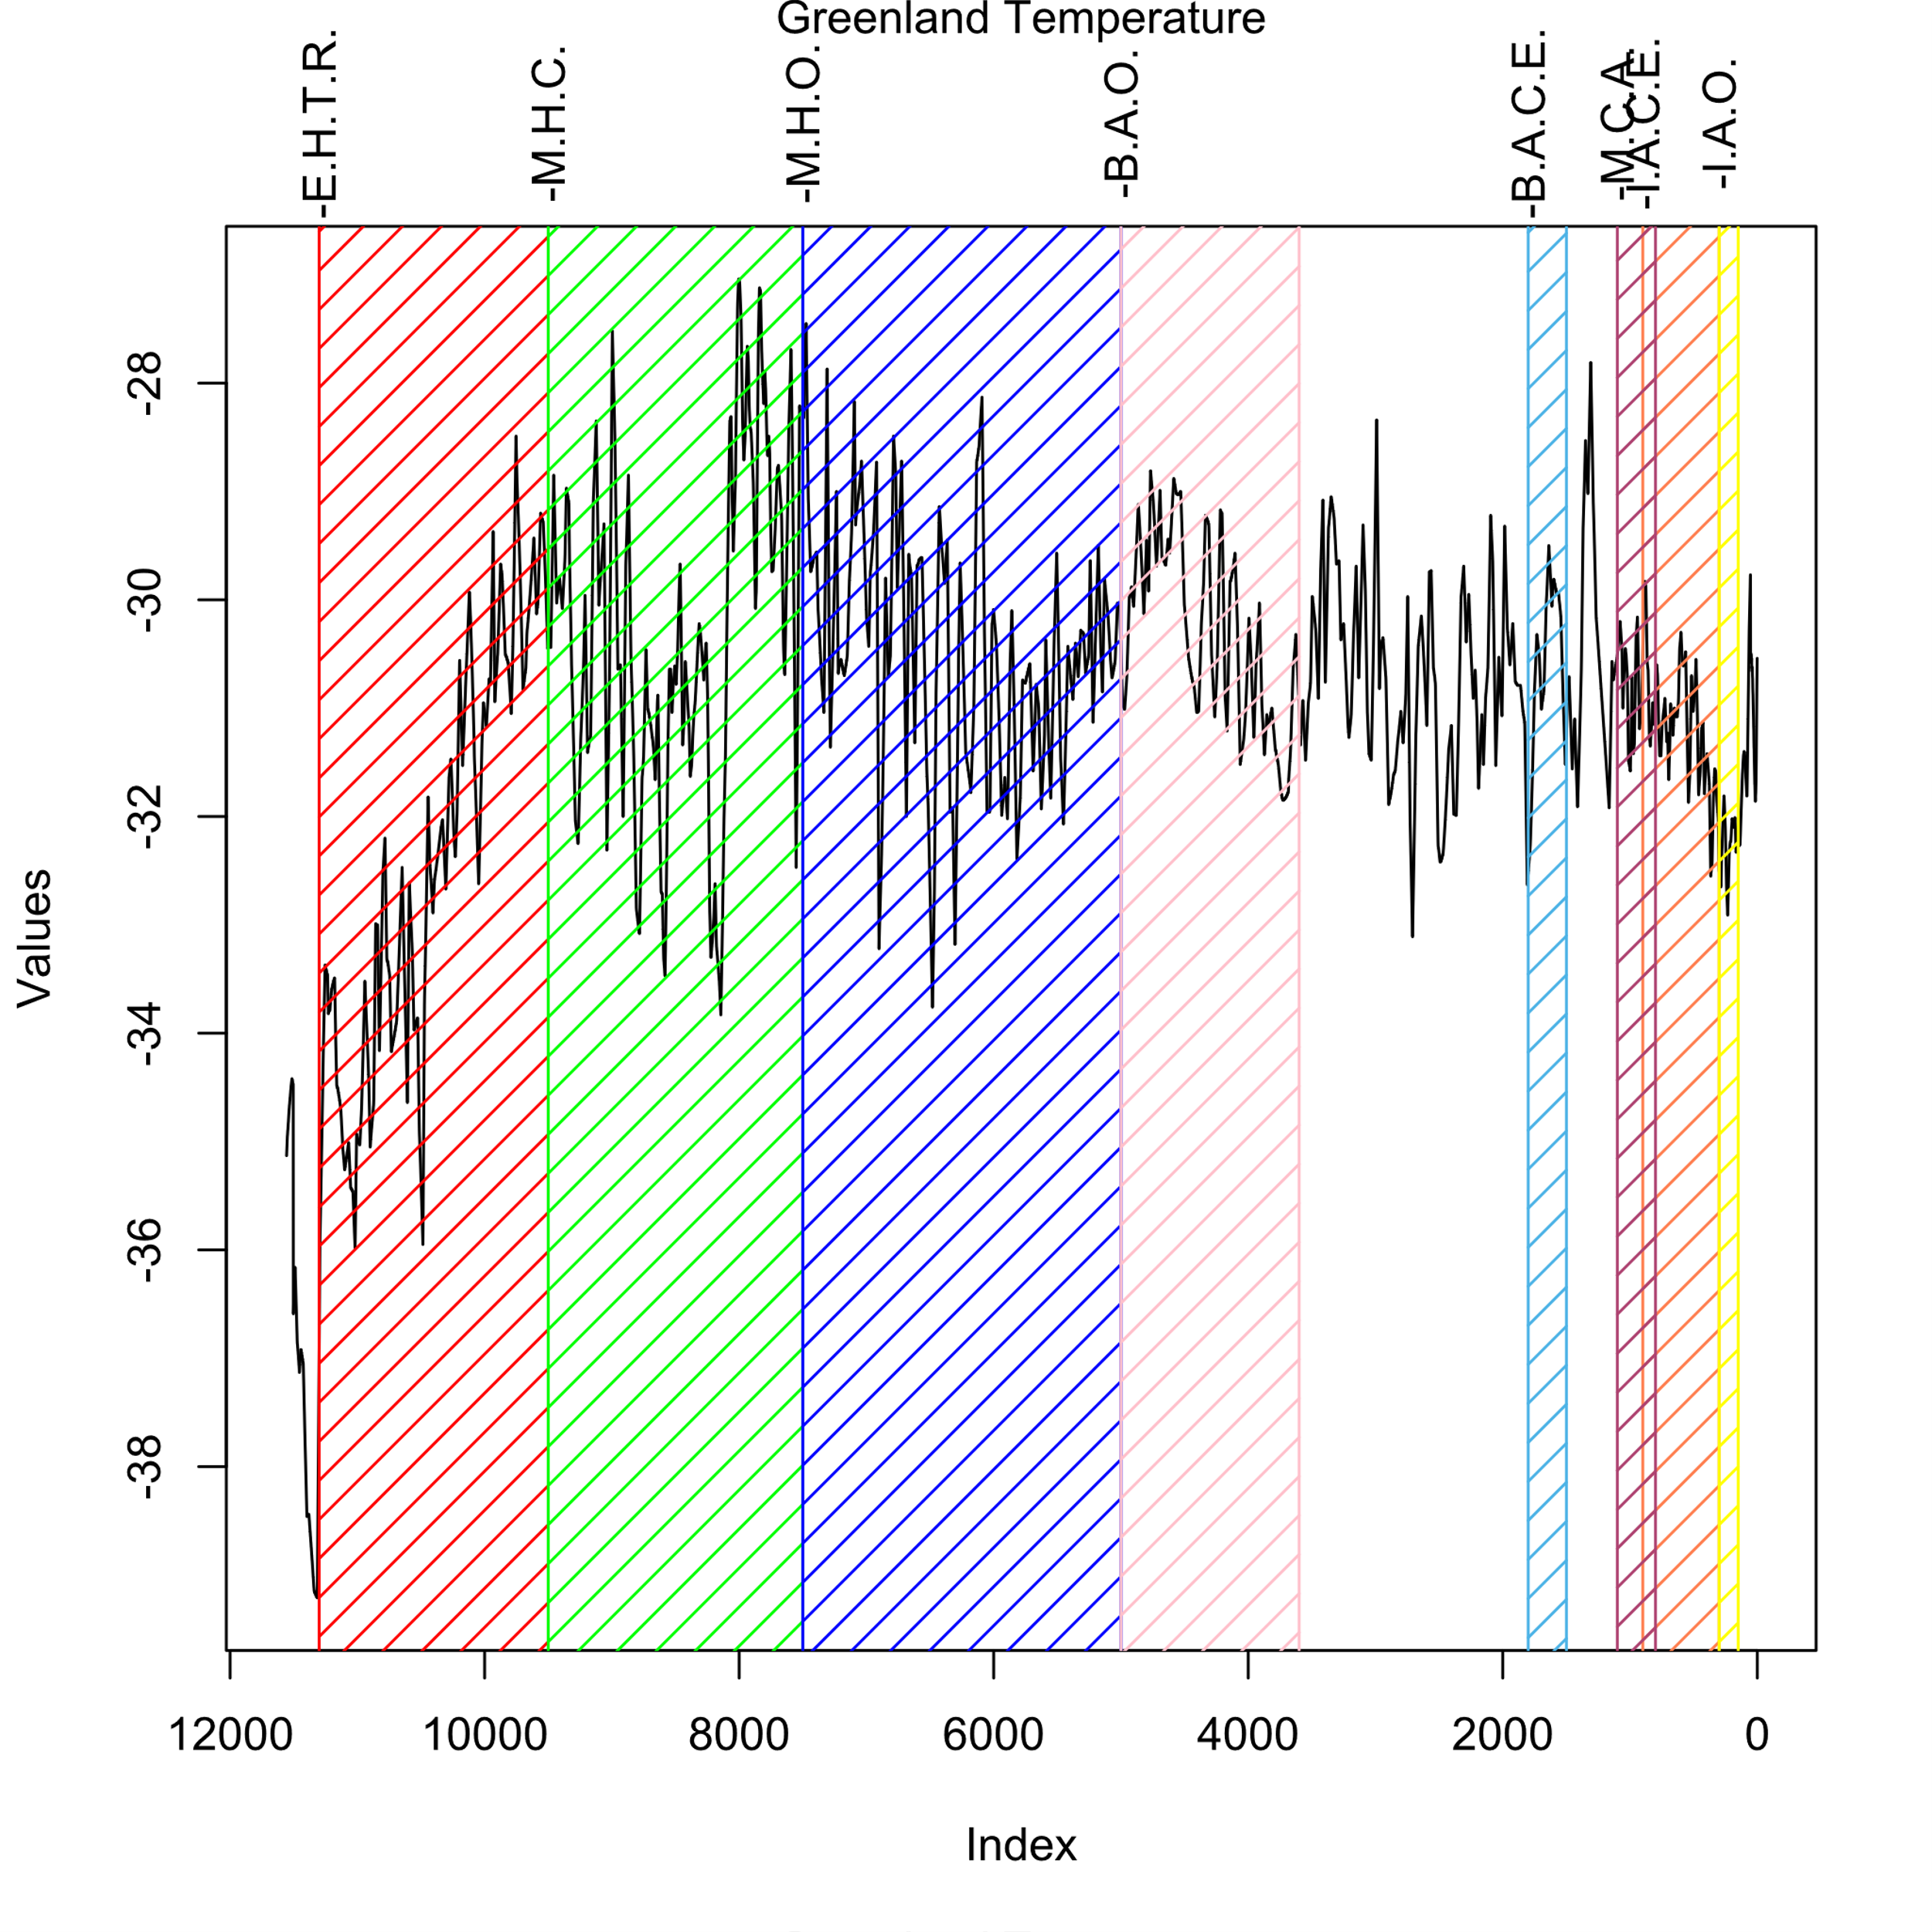
Ice Age, Age Determination, and Temperature Categorization
The Greenland Ice Core Chronology uses Radio Carbon-calibrated methods to determine the age of ice cores from Greenland.
The age of Greenland's past temperatures has been classified by some groups
These groups are:
E.H.T.R. = Early Holocene Temperature Rise
M.H.C. = Mid-Holocene Cooling
M.H.O. = Mid-Holocene Optimum
B.A.C.E. = Bronze Age Cold Epoch
B.A.O. = Bronze Age Optimum
I.A.C.E. = Iron Age Cold Epoch
I.A.O. = Iron Age Optimum
M.C.A. = Medieval Climate Anomaly

Slide 7
Objective
Figure out how the temperature of Greenland has changed over time. Moreover, try to create such a model to backcast past temperatures.

Slide 8
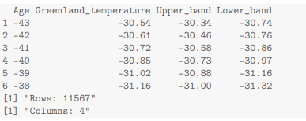
Data Overview and Preprocessing
Total Rows: 11,567
Total Columns: 4
Empty Rows: Each column contains some empty rows.
After removing empty rows, we have 11200 rows.

Slide 9
Summary Measures
 | Age | Greenland Temperature
Min. | -43 | -35.9
1st Quartile | 2773 | -31.4
Median | 5582 | -30.7
Mean | 5587 | -30.8
3rd Quartile | 8403 | -29.9
Max | 11157 | -27
The data shows that the youngest is -43 and the oldest is 11157. The lowest temperature is -35.9 degrees Celsius, the highest is -27 degrees Celsius, the average is -30.8 degrees Celsius, and the middle point is -30.7 degrees Celsius.

Slide 10
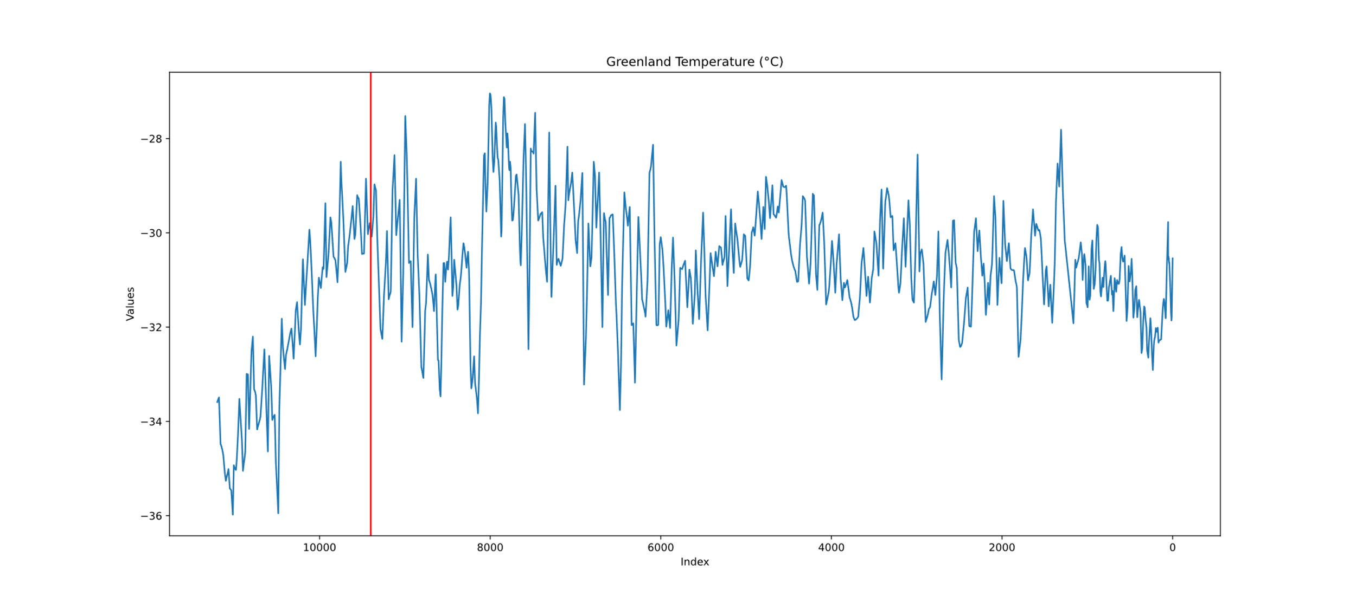
Line Plot
From the above line plot, we can see that after 9400, there is a downward trend.

Slide 11
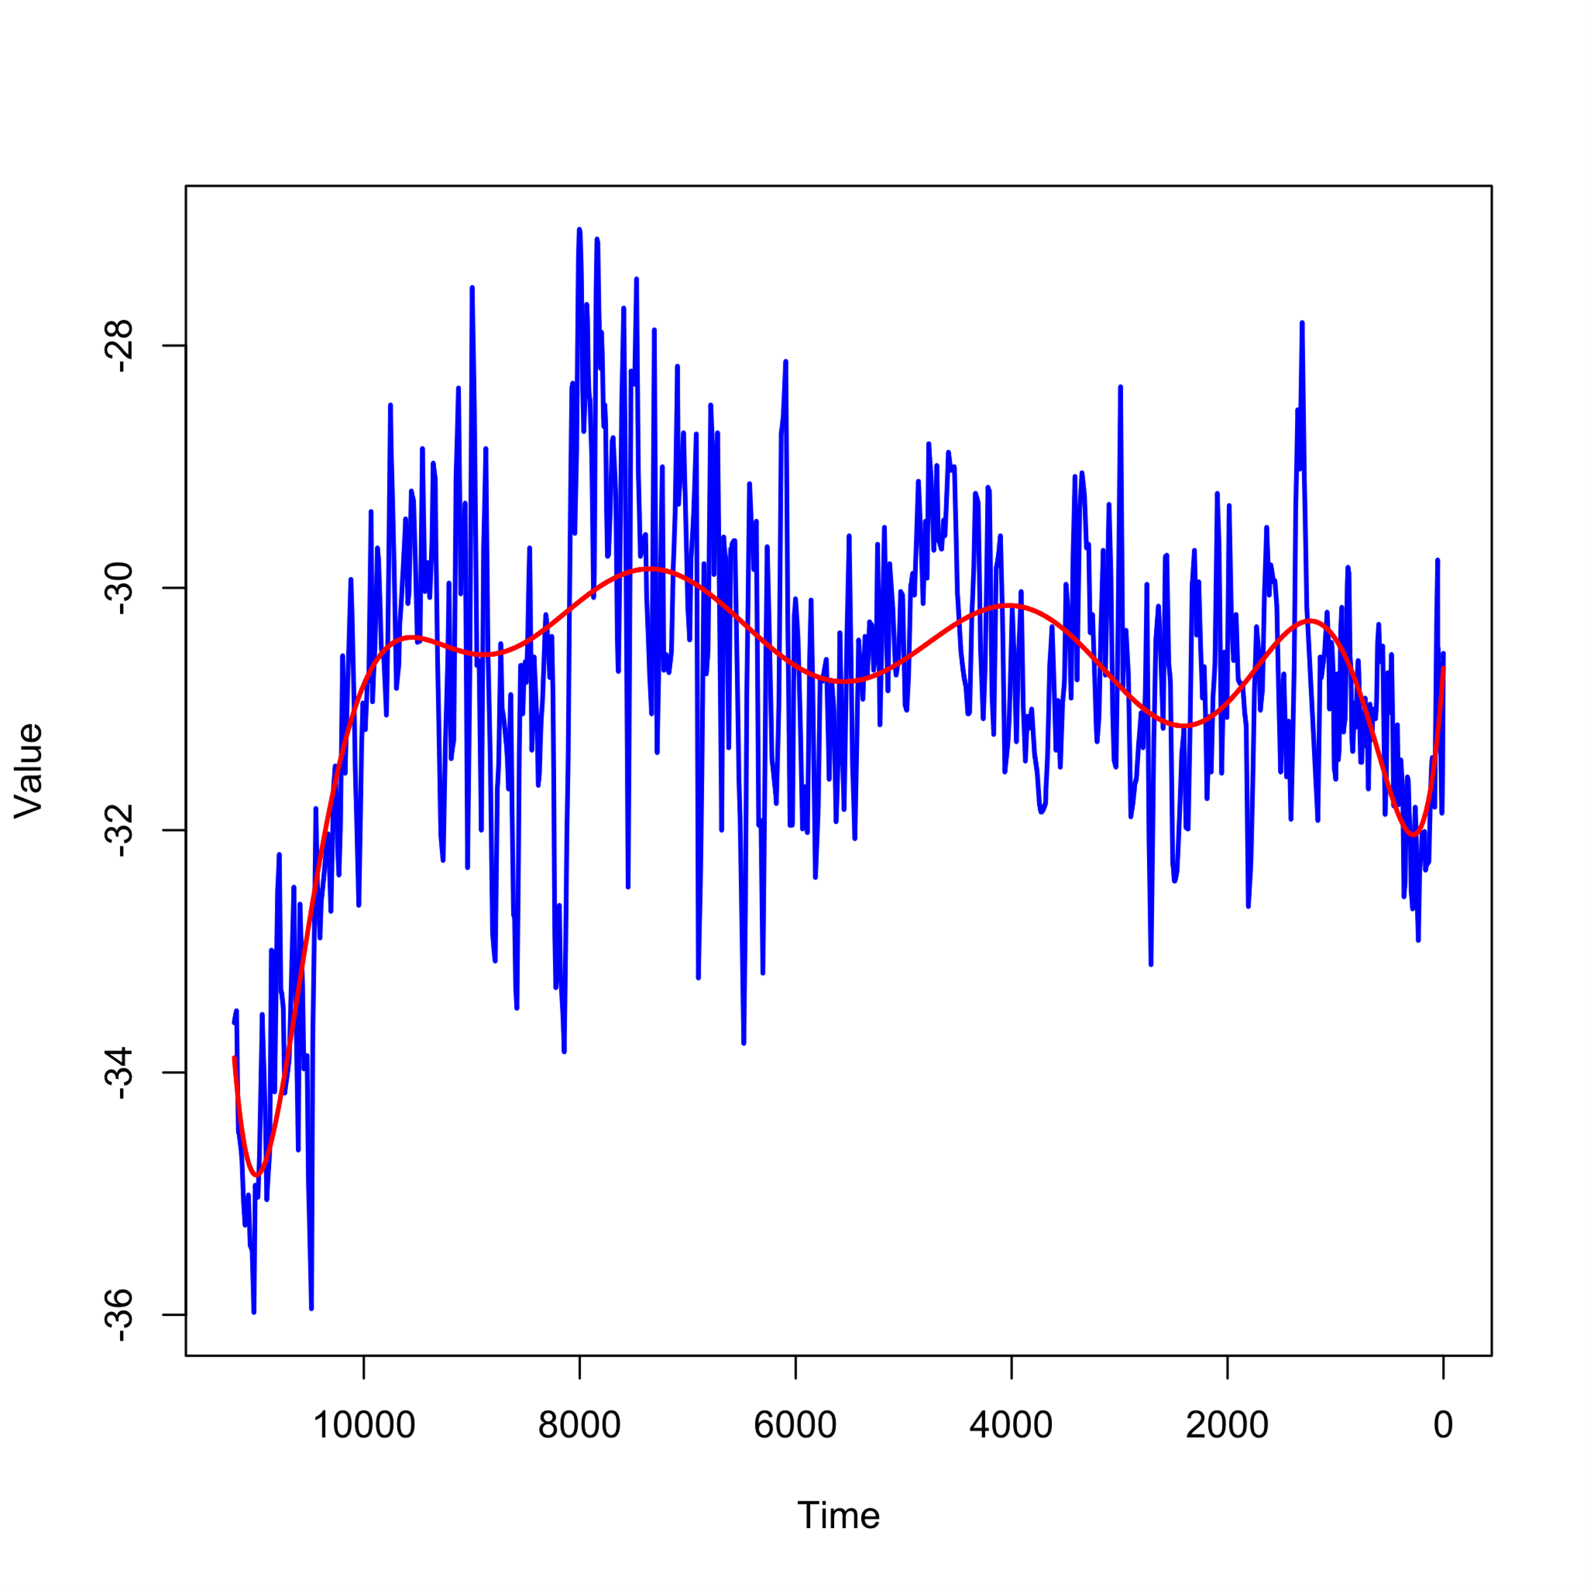
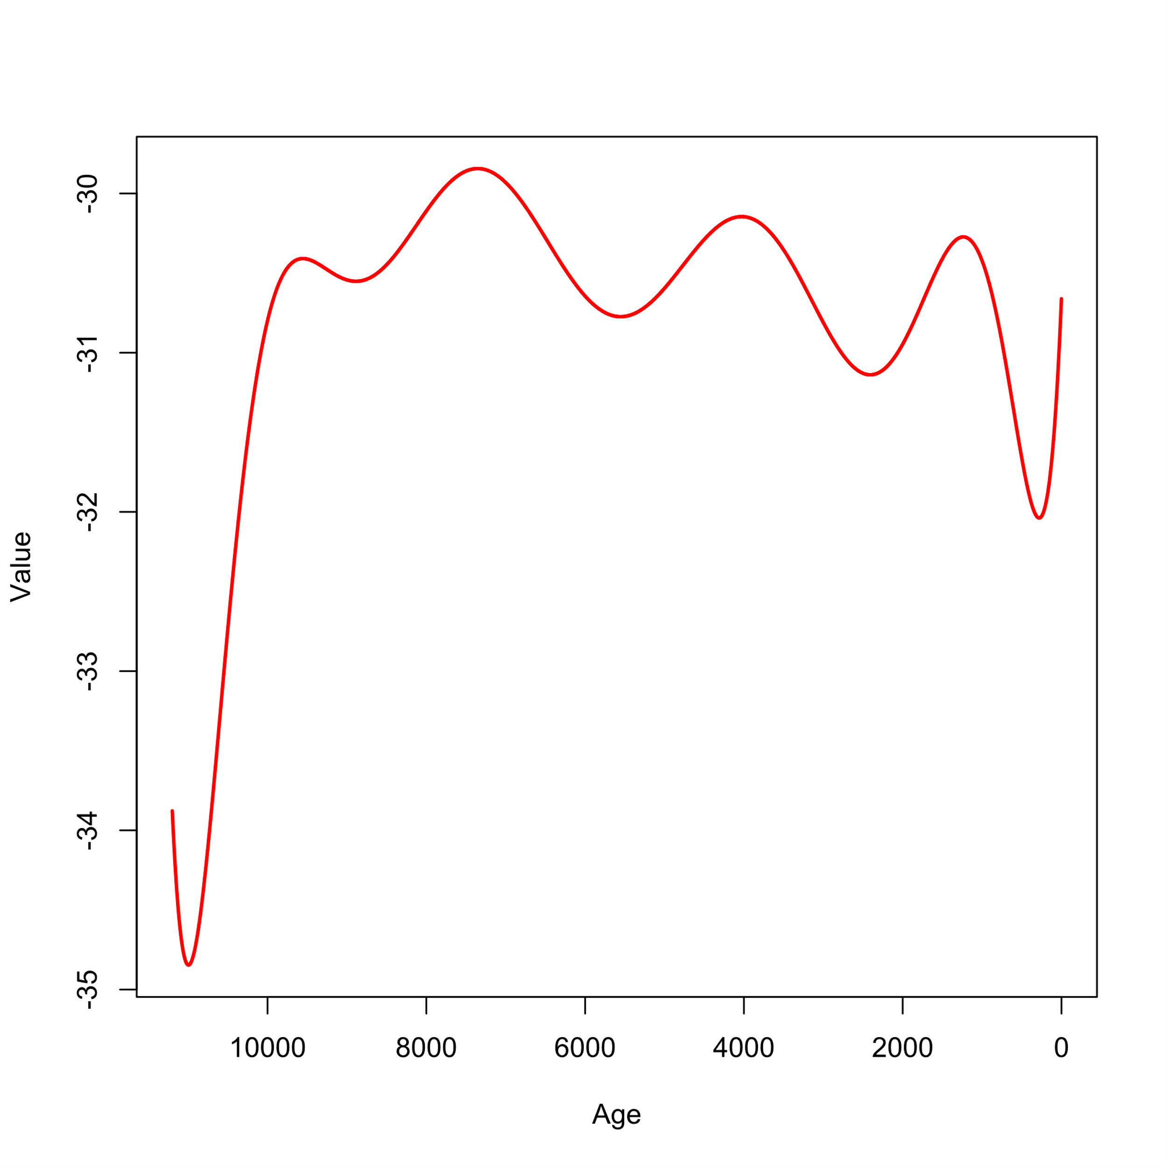
Exploring Trend and Seasonality Patterns
Used a 10-degree polynomial curve on the data.
A polynomial curve captures complex patterns and trends in the time series.
Absence of Pattern (0 to 9400):
Between 0 and 9400, there is no pattern that appears
No clear cyclic or seasonal pattern is evident during this period.
Downward Trend (9400 onwards):
After 9400, a noticeable downward trend is observed.
The data indicates a declining pattern beyond this point.

Slide 12
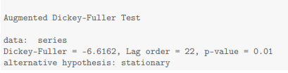
Augmented Dickey-Fuller Test
Test-Statistic: -6.61
Negative Test-statistic indicates strong evidence against the null hypothesis.
More negative values imply stronger evidence against the unit root (nonstationary).
P-Value: 0.01
P-value is used to determine the significance of the test.
P-value of 0.01 is less than the significance level of 0.05.
Conclusion:
Reject the null hypothesis and conclude that the time series is stationary.

Slide 13
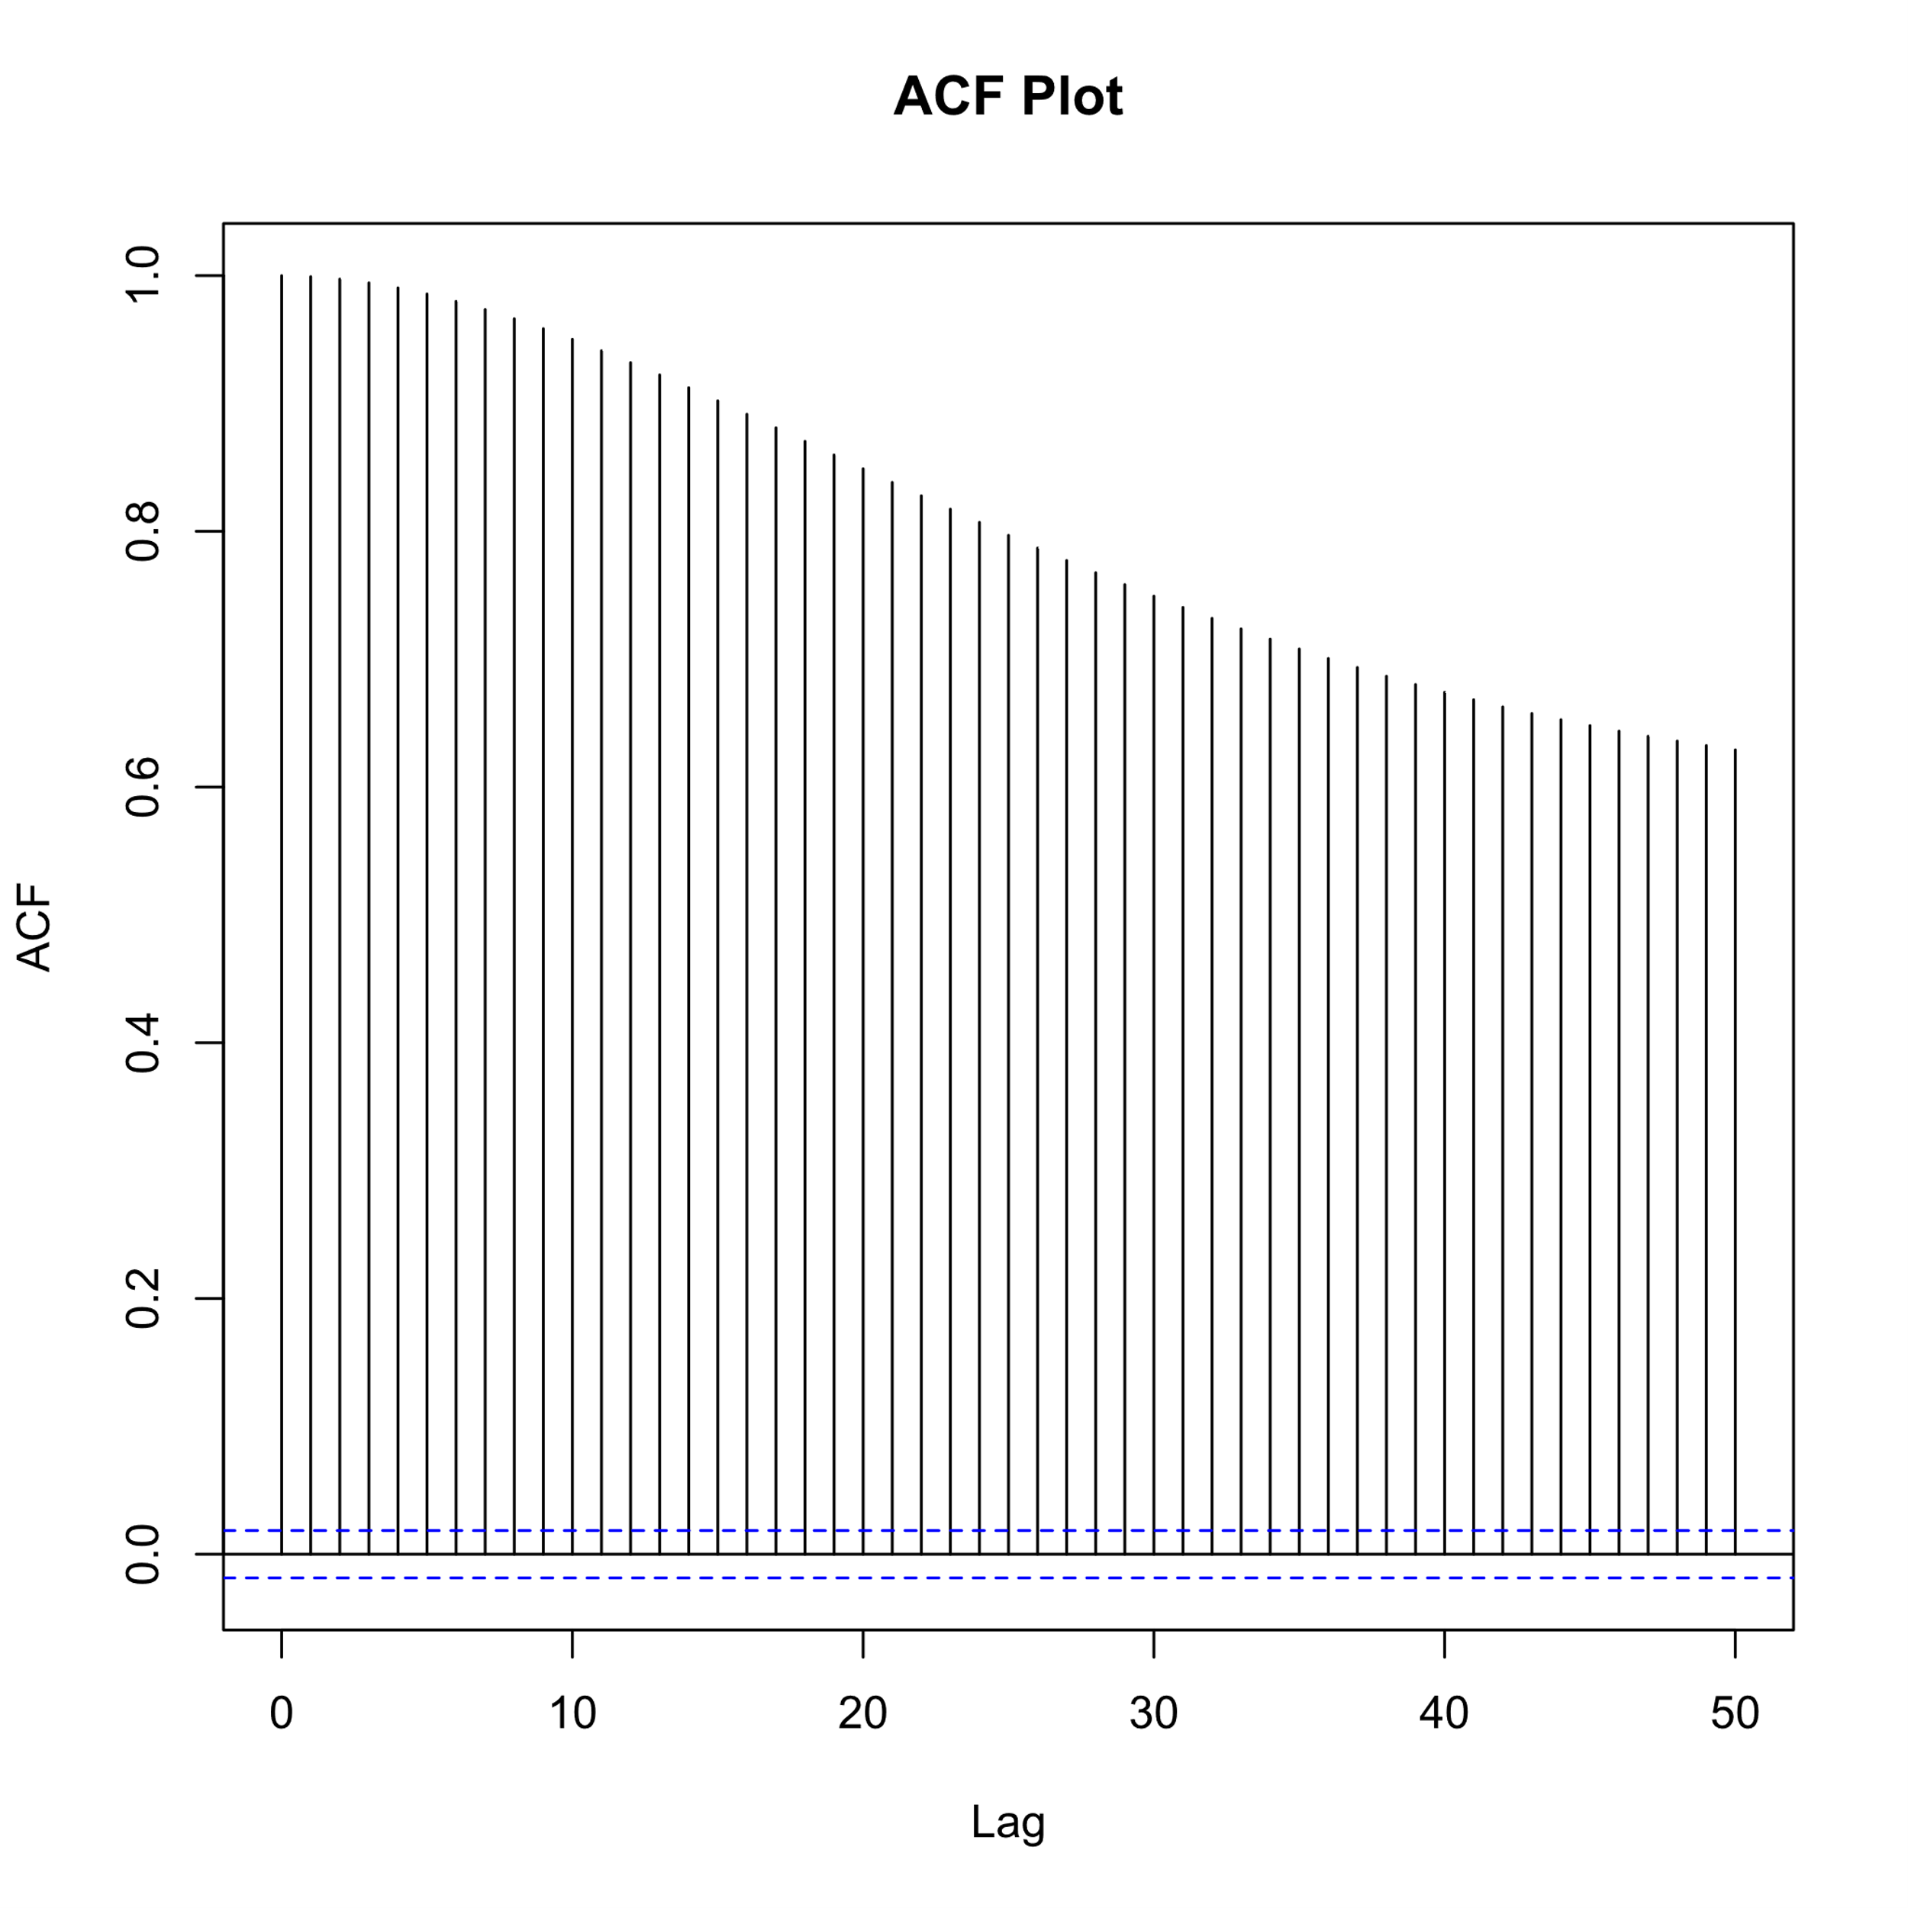
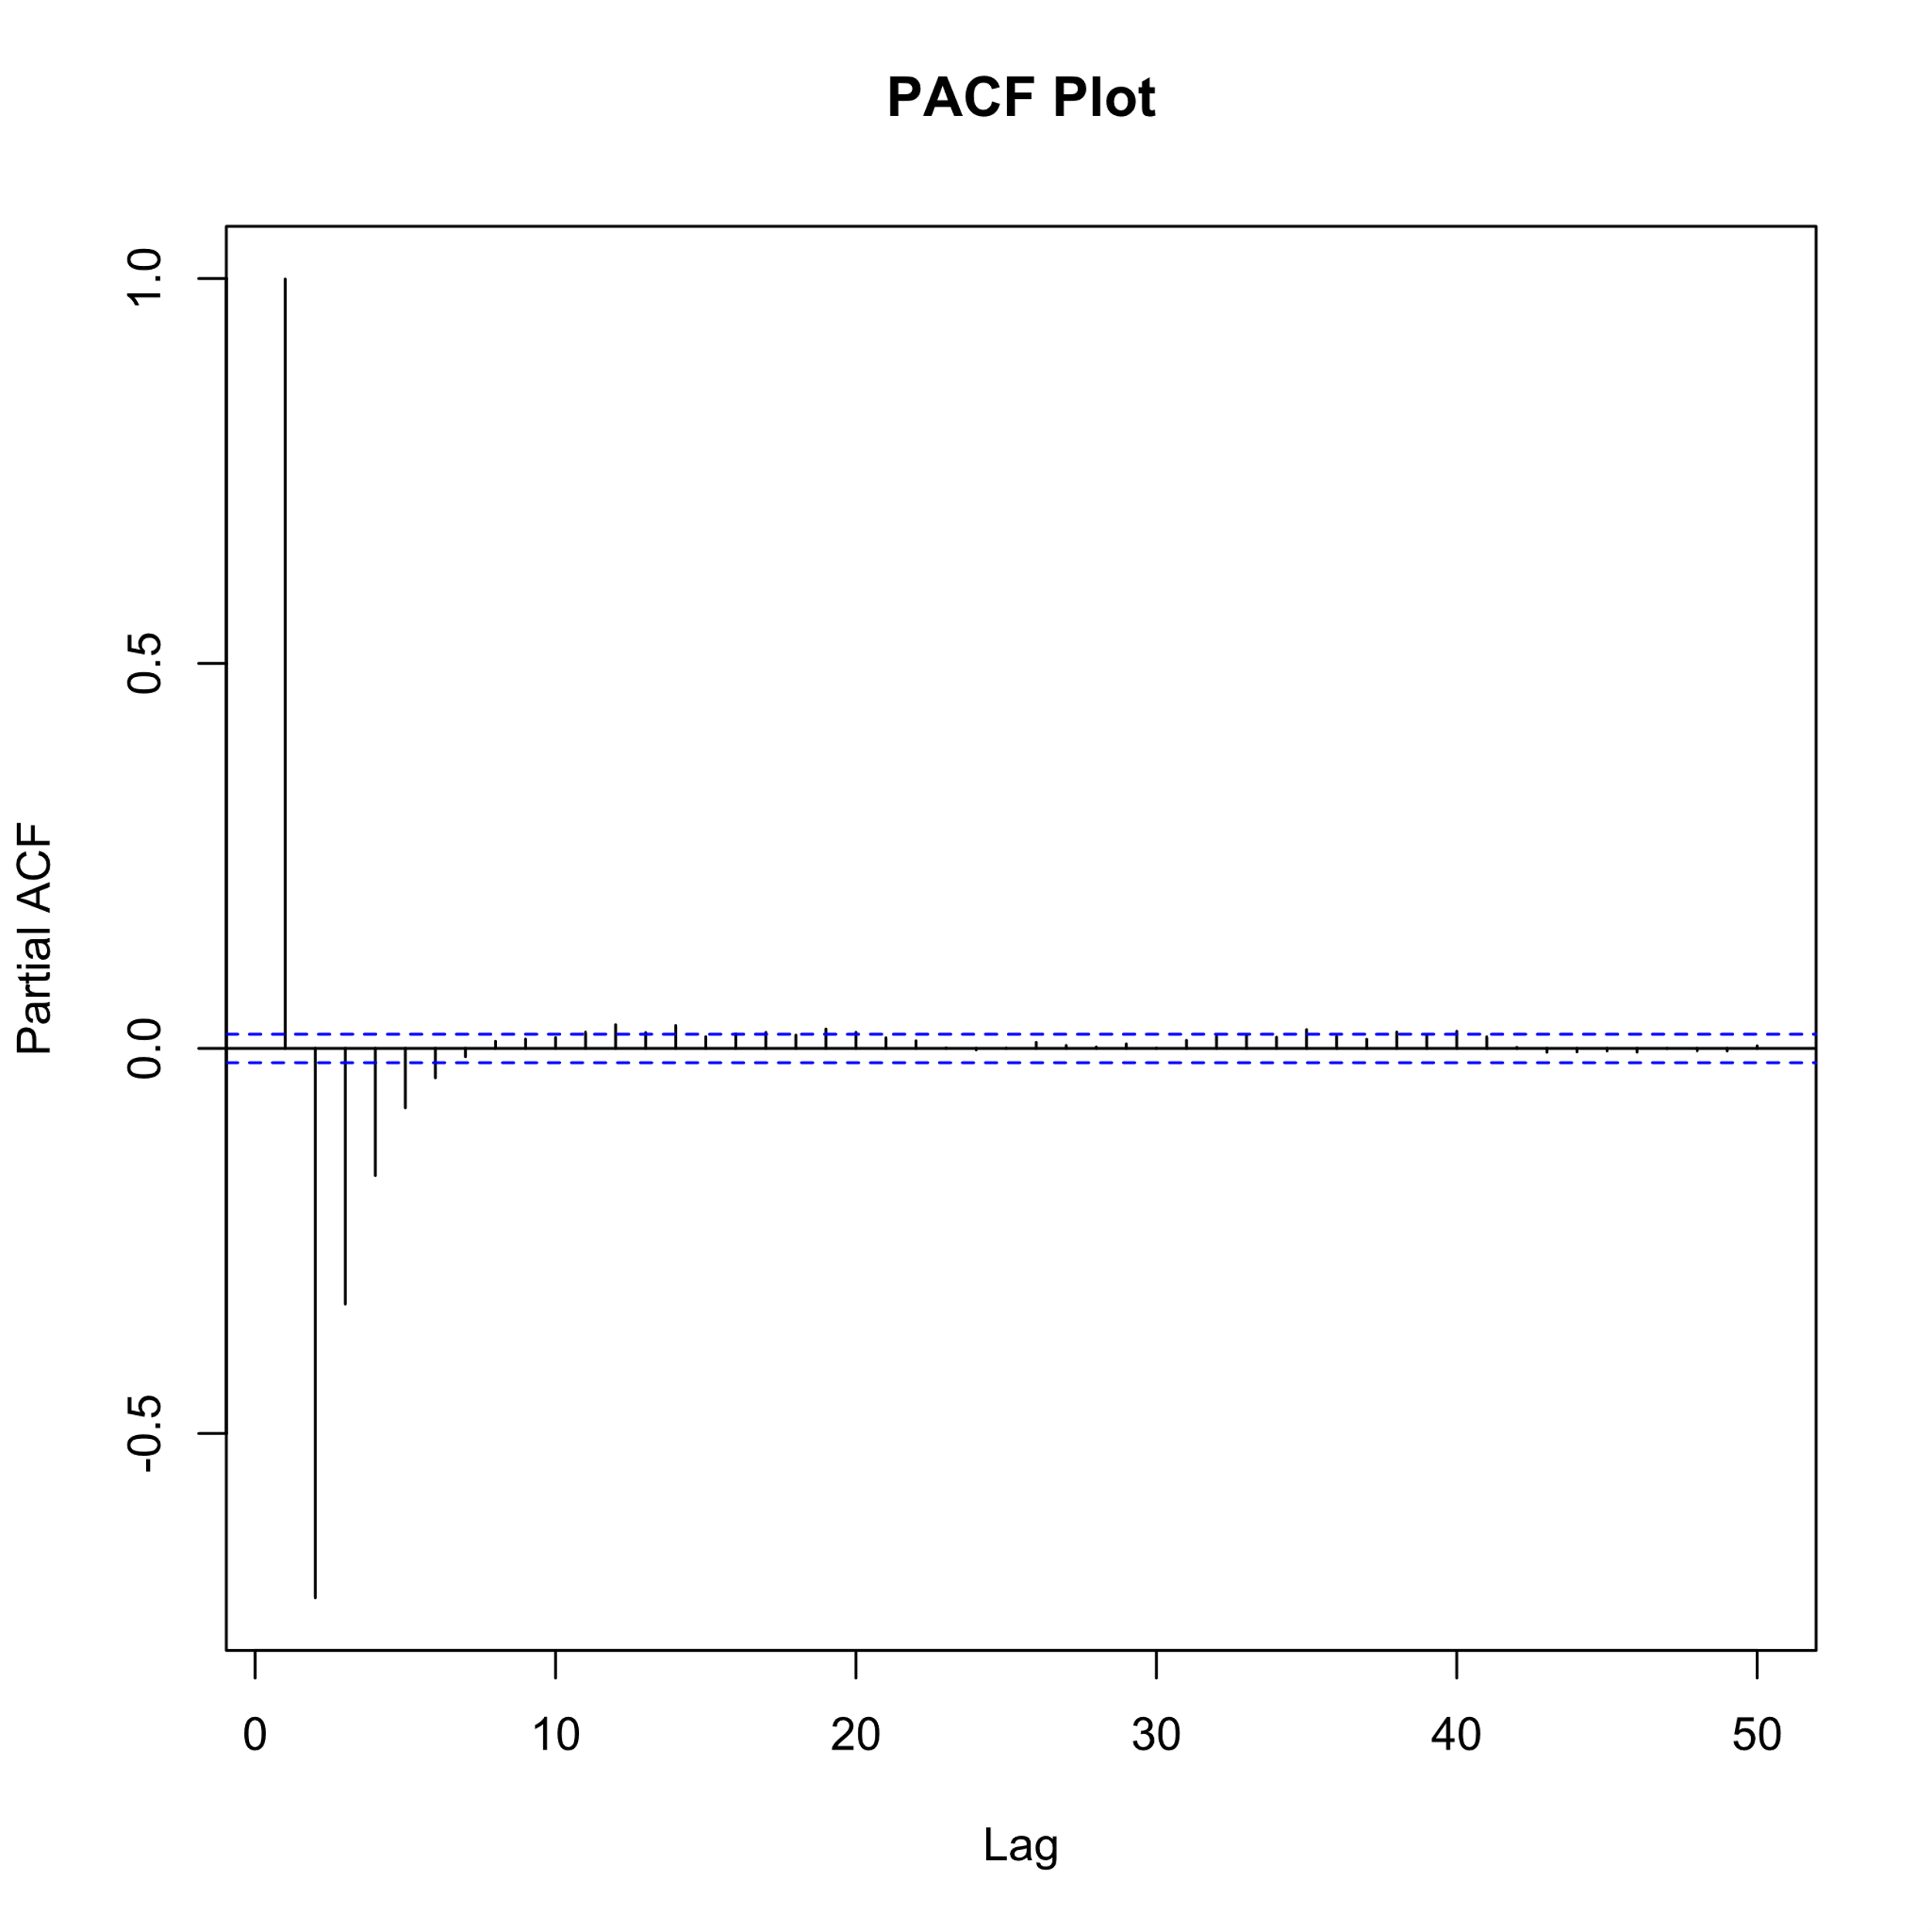
ACF and PACF Analysis for Model Selection
ACF Plot:
No sharp drop was observed in the ACF plot.
ACF plot shows a gradual decline in autocorrelation values.
PACF Plot:
Sharp drop observed after 2 or 3 lags in the PACF plot.
PACF plot indicates significant partial autocorrelation at these lags.
Model Selection:
Based on the ACF and PACF analysis, choose the AR model.
Order Selection:
Select the AR model with 2 or 3 orders.
The sharp drop in the PACF plot suggests the appropriate order for the AR model.

Slide 14
Splitting into Train and Test Sets
The series is divided into a train set (80%) and a test set (20%).
Train: 8,960 data points (80% of the original series).
Test: 2,240 data points (20% of the original series).
Train set is used for model training and parameter estimation.
The test set is reserved for evaluating model performance on unseen data.
Importance: Analyzes model prediction, prevents overfitting, and provides an unbiased estimation of model performance.

Slide 15
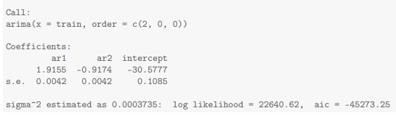
Autoregressive Model OR AR(2) Model
AR(1) Coefficient: 1.92
Each unit increase in the value at lag one is associated with a 1.92 unit increase in the past value.
AR(2) Coefficient: -0.92
Each unit increase in the value at lag two is associated with a 0.92 unit decrease in the past value.
Implications:
AR(1): Positive coefficient indicates a positive relationship between present and lags one.
AR(2): Negative coefficient suggests a negative relationship between present and lags two.

Slide 16
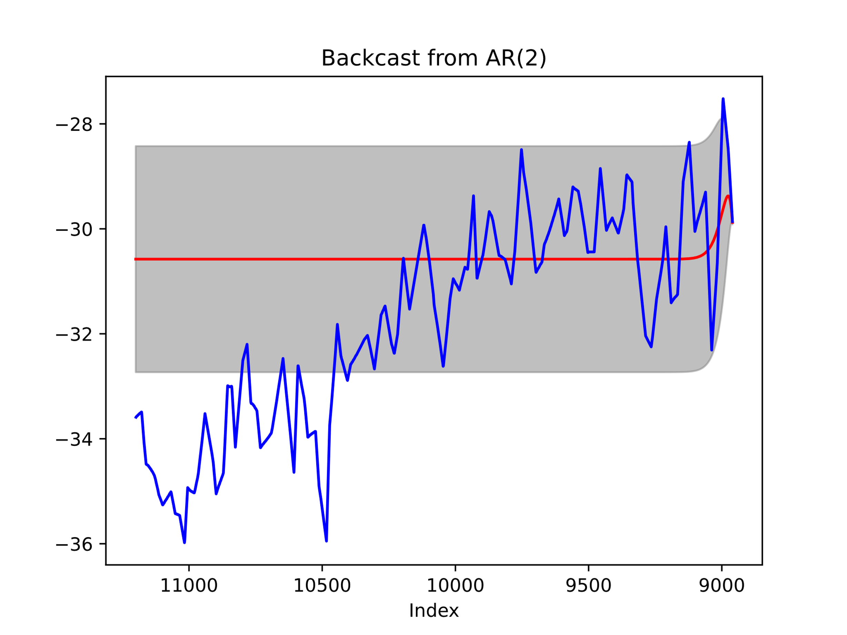
Plot Backcasted Value vs. Actual Temperatures with Confidence Band
Red Line: Backcasted temperature values.
Blue Line: Actual past temperature values.
Gray-Shaded Region: 95% Confidence Band.
Goodness of Fit on Test Data:
Model evaluation on test data resulted in poor performance.
The AR model fails to accurately predict or capture patterns in the test data.
Implications:
The current AR model may not effectively capture the complexity of the data.
To improve performance, more analysis and modiﬁcations to the model are needed.
This poor performance may be due to data splitting. the test data contain the trend part
Measures | Value
MSE | 5.1
RMSE | 2.2
R-square | -0.3
AIC | 3695.5
BIC | 3706.9

Slide 17
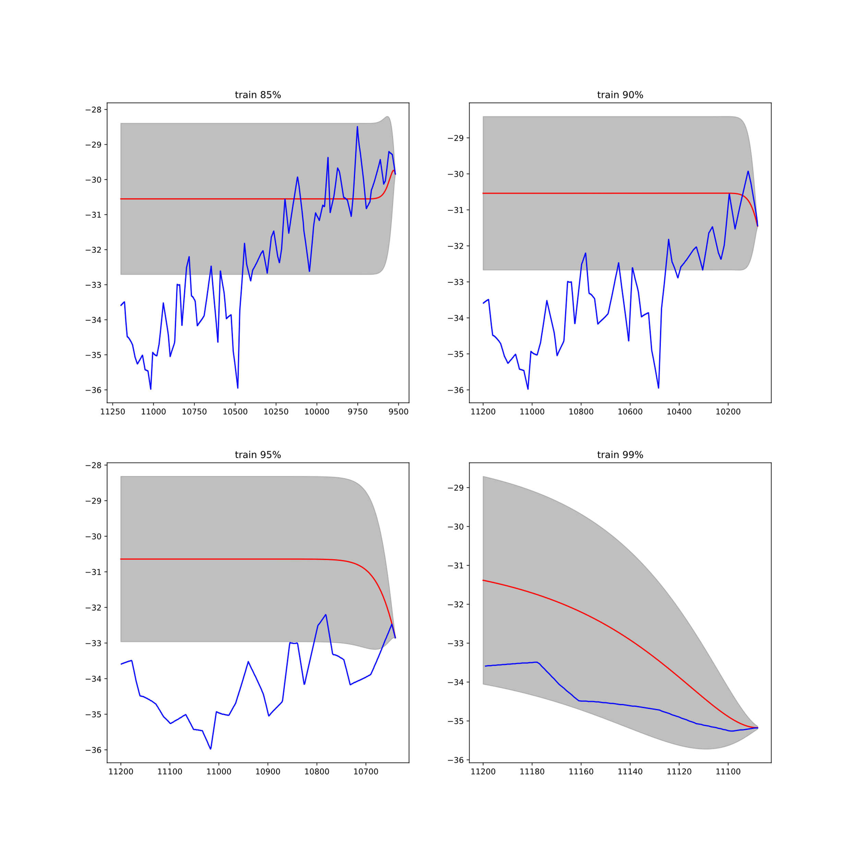
Impact of Varying Train-Test Split on Model Performance
 | MSE | RMSE | AIC | BIC | R-Sq
Train 85% | 6.6 | 2.5 | 3181.6 | 3192.4 | -0.8
Train 90% | 9.6 | 3.1 | 2548.7 | 2558.7 | -3.8
Train 95% | 12.7 | 3.5 | 1429.1 | 1437.8 | -14.9
Train 99% | 2.5 | 1.6 | 110.6 | 116.1 | -6.1
Train-Test Split:
Experimenting with different split percentages: 85%, 90%, 95%, and 99% of the total series as training, with the rest as test data.
Implications:
Adjusting the train-test split percentages may yield improved model performance, enabling a better understanding of underlying trends and patterns.
It shows that the model performs better as we increase the size of the training dataset. But overall, this model was not performing well.

Slide 18

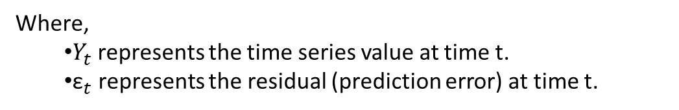
ARMA(3,5) Model
Model fitting :
The order of the ARMA model (3,5) was selected using a grid search with the smallest AIC value.
Evaluation of the ARMA(3,5) model on test data showed no significant improvement over the AR(2) model.
Measures | Value
MSE | 5.1
RMSE | 2.2
R-Squared | -0.3
AIC | 369.6
BIC | 3706.1
Where,
$Y_{t}$represents the time series value at time t.
${\text{ε}}_{t}$ represents the residual (prediction error) at time t.

Slide 19
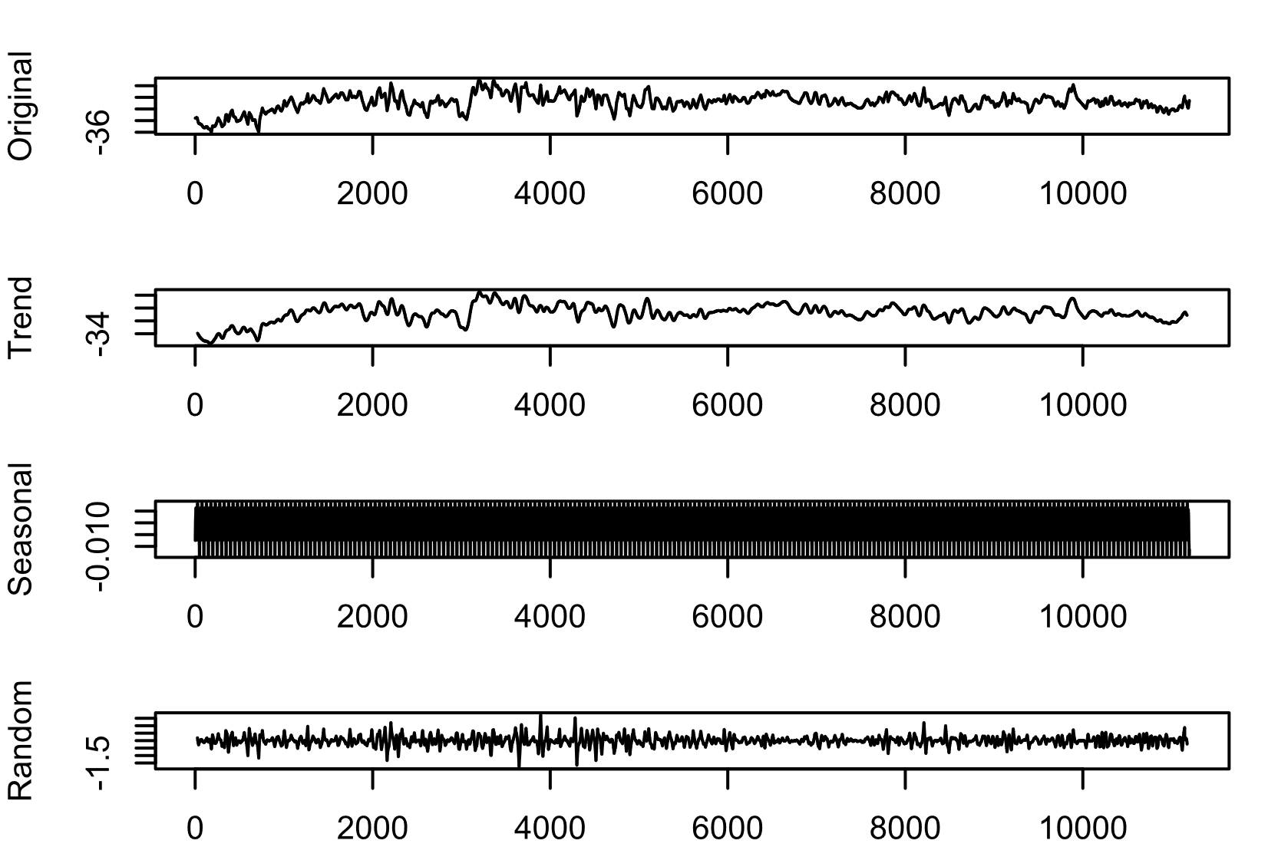
Decomposition
So far, we have assumed no trend or seasonality in the data. In that way, we tried to fit different models but could not find a suitable model. So there were trends and seasonality that didn’t fit our models well. So now, using the Decomposition method, we remove trend & Seasonality from the time series. Then we fit the model with the remaining residuals.

Slide 20
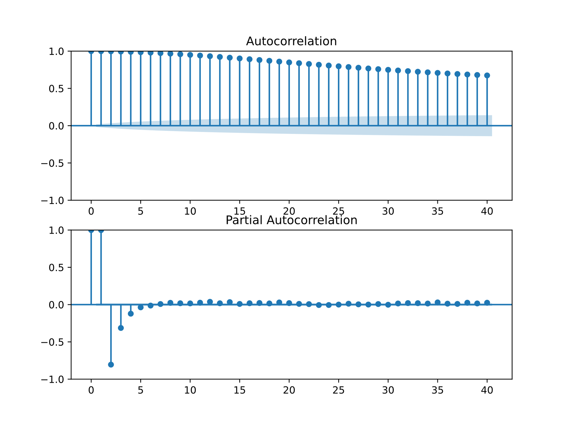
ACF & PACF Plot
The ACF and PACF plots show that there is a sharp drop after 2 or 3 lags, which suggests fitting AR(2) or AR (3). The residual components are split into train and test data, the training dataset has 8960 rows, and the test dataset has 2240 rows.

Slide 21
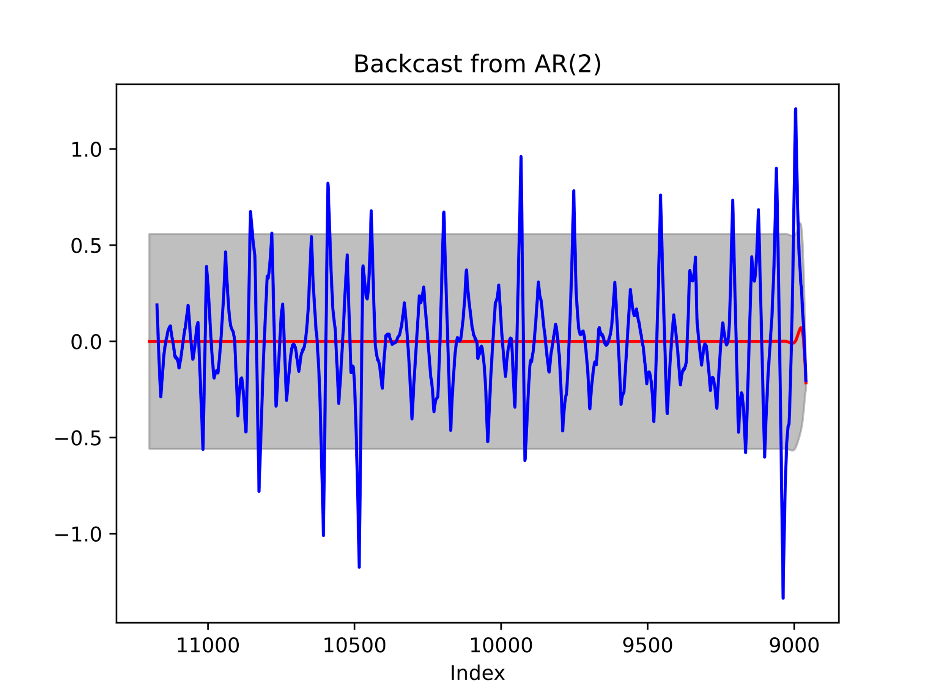
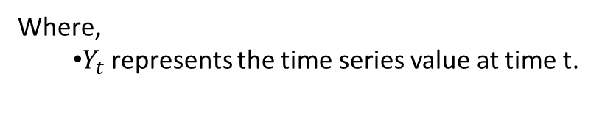
AR(2) model
According to the PACF plot, the AR model is fitted with order p= 2
Here the goodness of fit between this and the previous one is nearly the same. There are no such differences from the previous one. So we have not tried any other model on this since there is no such difference in the outcomes.
Measure | Value
MSE | 0.1
RMSE | 0.3
R-Squared | 0.004
AIC | -5474.4
BIC | -5462.9
Where,
$Y_{t}$represents the time series value at time t.

Slide 22
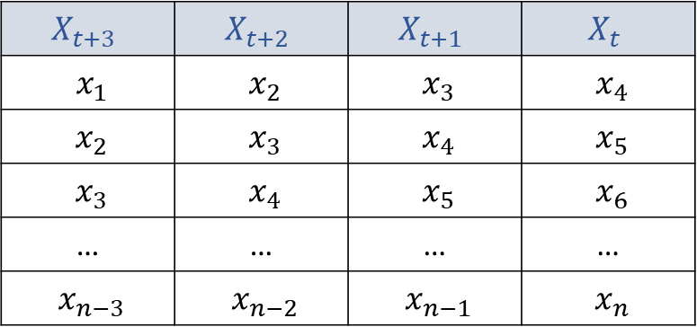
Advance techniques
The previous ACF and PACF plots show that the value at the nth position well correlates with the values at the (n+1)th, (n + 2)th, and (n + 3)th positions. So converted the series into a matrix; if we have series like (x1, x2, x3, x4, ...) it converted into a matrix that looks like
$$X_{t+3}$$ | $$X_{t+2}$$ | $$X_{t+1}$$ | $$X_{t}$$
$x_{1}$ | $x_{2}$ | $x_{3}$ | $x_{4}$
$x_{2}$ | $x_{3}$ | $x_{4}$ | $x_{5}$
$x_{3}$ | $x_{4}$ | $x_{5}$ | $x_{6}$
… | … | … | …
$x_{n−3}$ | $x_{n−2}$ | $x_{n−1}$ | $x_{n}$
Now Split 80% of the data as a training dataset; the rest 20% as test data. On the training dataset, a linear regression model was fit, and predictions were made on the test dataset, When compared to the actual value, the predicted values were so close to each other that they almost overlapped.

Slide 23
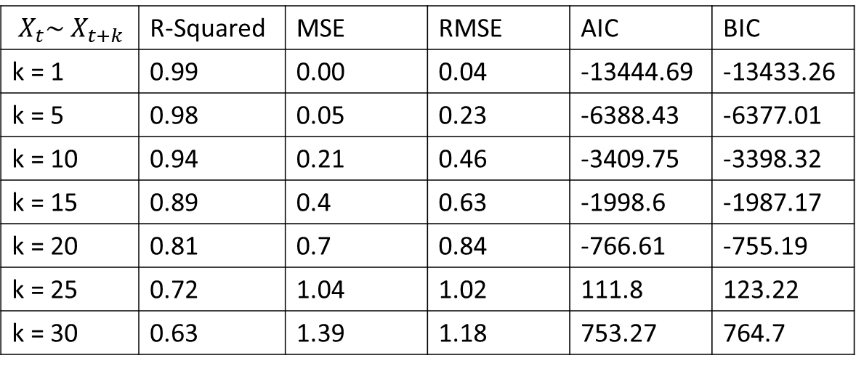
Model Performance
In linear model I used $X_{t+k}$ columns to predict $X_{t}$ column, We are now testing how well our model works for different values of ok k.
$X_{t}$∼ $X_{t+k}$ | R-Squared | MSE | RMSE | AIC | BIC
k = 1 | 0.99 | 0.00 | 0.04 | -13444.69 | -13433.26
k = 5 | 0.98 | 0.05 | 0.23 | -6388.43 | -6377.01
k = 10 | 0.94 | 0.21 | 0.46 | -3409.75 | -3398.32
k = 15 | 0.89 | 0.4 | 0.63 | -1998.6 | -1987.17
k = 20 | 0.81 | 0.7 | 0.84 | -766.61 | -755.19
k = 25 | 0.72 | 1.04 | 1.02 | 111.8 | 123.22
k = 30 | 0.63 | 1.39 | 1.18 | 753.27 | 764.7
Obviously, if we increase the value of k, accuracy will decrease. But Here, we can see that even if we gradually increase the value of k, the performance of our model decreases very slowly. Overall our method is performing well.

Slide 24
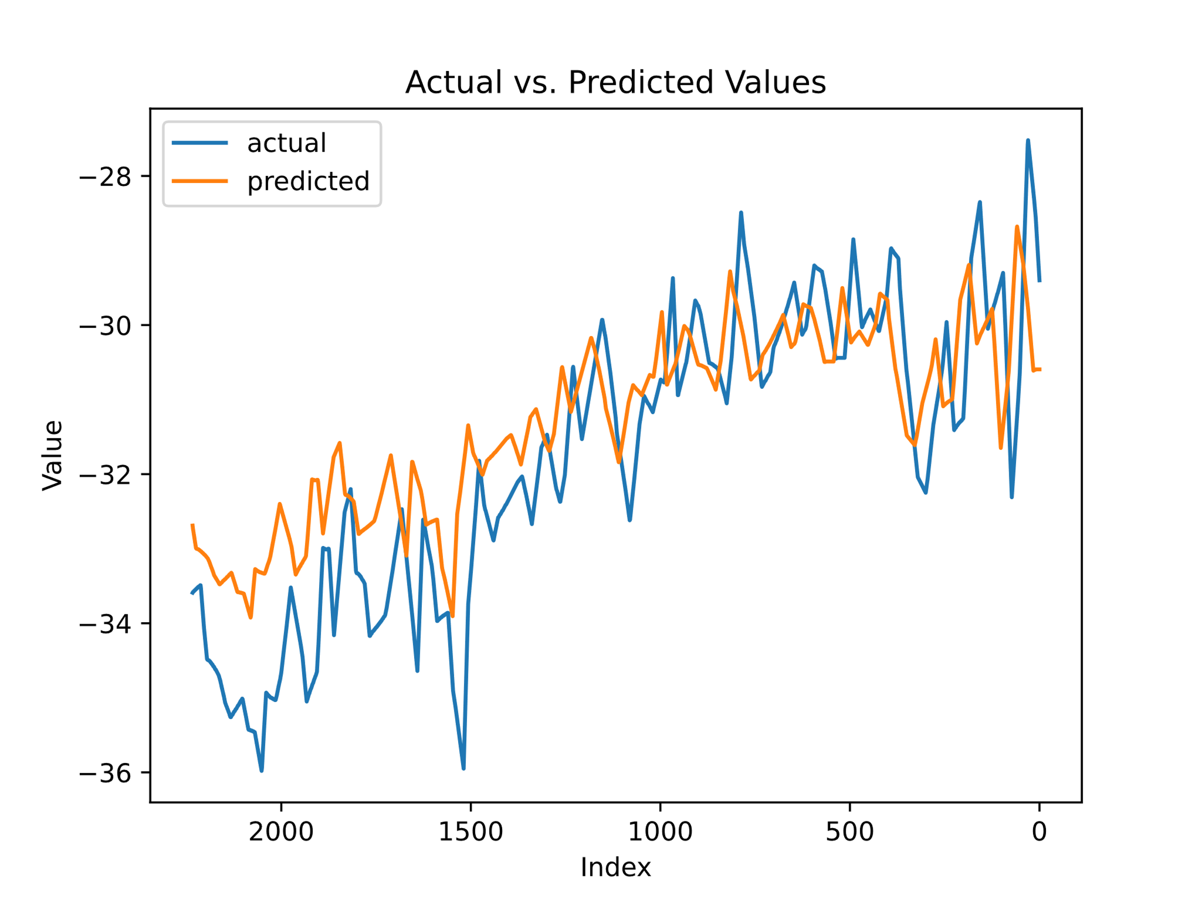
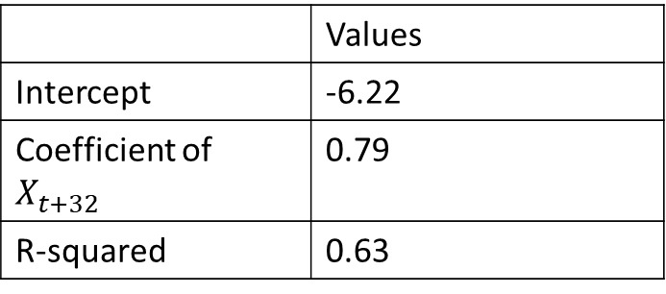
Plot Backcasted Value vs. Actual Temperatures for k = 32
the linear model is fitted with k equal to 32. After fitting the linear model, the coefficients are
 | Values
Intercept | -6.22
Coefficient of $X_{t+32}$ | 0.79
R-squared | 0.63

Slide 25
Multivariate Analysis
In the search for long-term backcasting with univariate analysis, there have been a number of problems that have come up. Reading a lot of research papers has shown that the temperatures of the paleoclimate depend on a lot of different factors. To fix this, researchers have started looking into processes related to temperature to find the right variables. After a thorough search, a number of possible factors have been found:
CO2 (ppm): Carbon dioxide levels in the atmosphere significantly contribute to climate change.
Volcanic Eruption Temperature (°C): Temperature anomalies resulting from volcanic eruptions and their impact on climate.
Ice Surface Temperature (°C): Temperature measurements obtained from ice surfaces, providing insights into past climatic conditions.
These variables hold promise for understanding long-term backcasting and its implications for climate research.

Slide 26
Study and Dataset Overview
Scientific Study:
The Greenland 11,500-Year Temperature Reconstruction is a comprehensive study conducted by a team of investigators, including Kobashi et al. The dataset provides valuable insights into Greenland's temperature variations over the past 11,500 years.
Key Variables:
The dataset includes measurements of carbon dioxide (CO2) levels in parts per million, time series of volcanic forcing, and climate model output for Northern Hemisphere temperature. These variables illustrate the impact of CO2 and volcanic activity on climate.
Data Archives:
Both the study and dataset are stored at the World Data Service for Paleoclimatology in Boulder, Colorado, and the NOAA Paleoclimatology Program at the National Centers for Environmental Information (NCEI).
This study and dataset provide valuable information about past climate variations in Greenland, contributing to our understanding of long-term temperature trends.

Slide 27
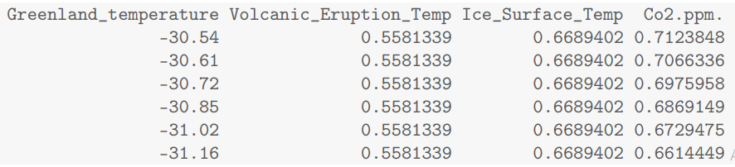
Dataset
Rows: 11,556: The dataset contains 11,556 rows or observations.
Columns: 4: The dataset has four columns or variables.

Slide 28
Summary Measure
 | Greenland temperature | Volcanic Eruption Temperature (°C) | Ice Surface Temperature (°C) | Co2.ppm.
Min. | -39.2 | -1.5 | -0.7 | 182
1st Qu. | -31.5 | -0.1 | 0 | 252.5
Median | -30.7 | 0 | 0 | 258.3
Mean | -30.9 | -0.1 | 0 | 255.5
3rd Qu. | -29.9 | 0.1 | 0.1 | 264.4
Max. | -27 | 0.6 | 0.7 | 298
These summaries provide a general understanding of temperature, Volcanic Eruption Temperature (°C), Ice Surface Temperature (°C), and CO2 focus measurements across the dataset. However, additional context and analysis are required for meaningful insights. The summary includes key statistics such as minimum, first quartile, median, mean, third quartile, and maximum. These measures help understand the range, central tendency, and variability of data in each column.

Slide 29
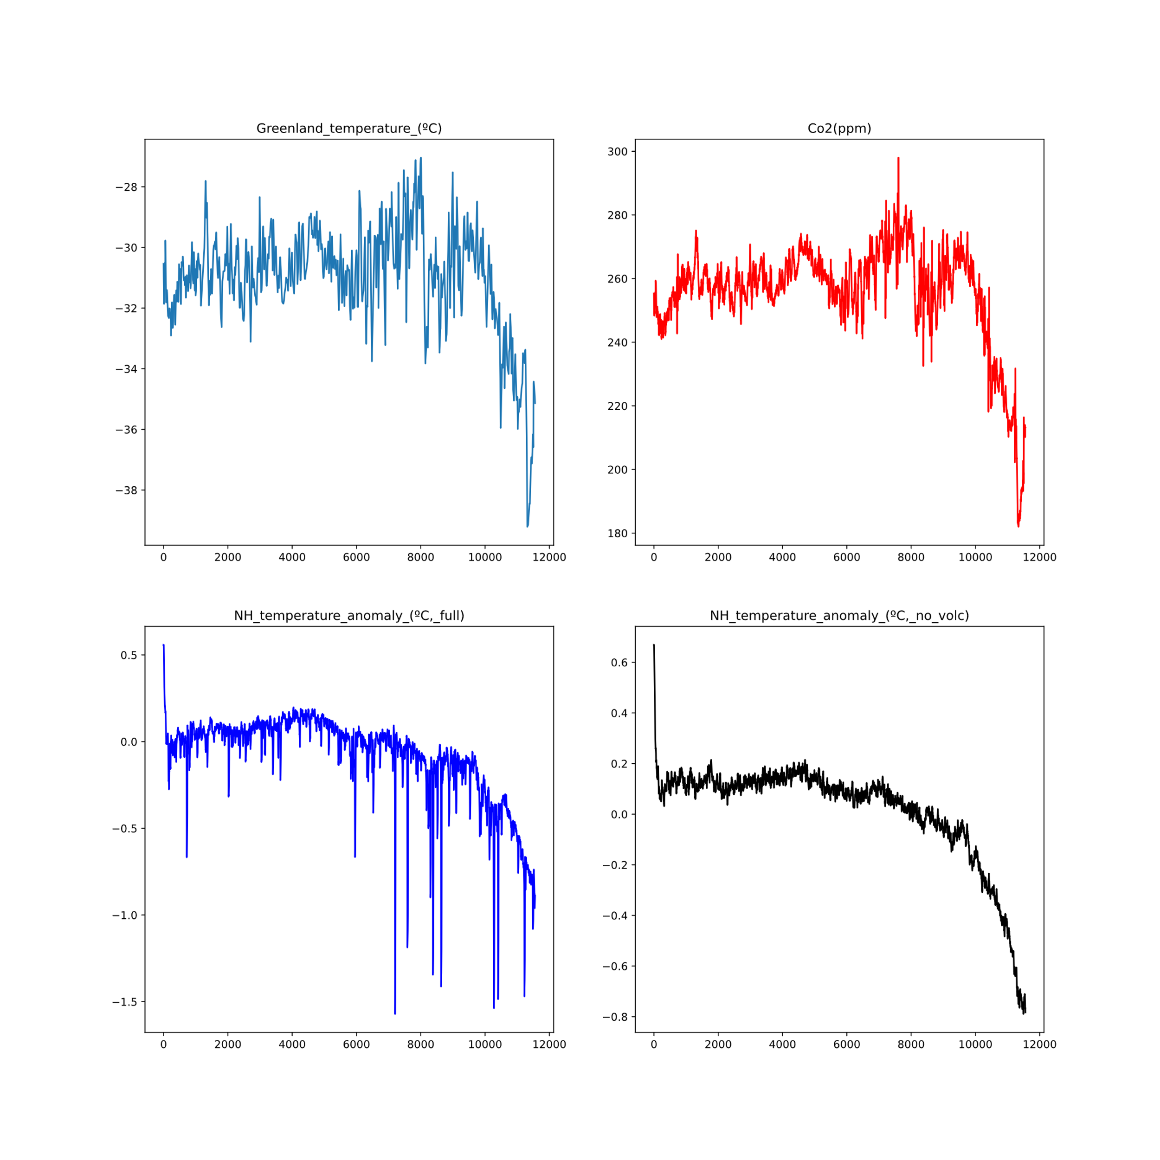
Line plot of each variable

Slide 30
Correlation Matrix
 | Greenland temperature (°C) | Volcanic Eruption Temperature (°C) | Ice Surface Temperature (°C) | Co2(ppm)
Greenland temperature (°C) | 1 | 0.53 | 0.68 | 0.96
Volcanic Eruption Temperature (°C) | 0.53 | 1 | 0.82 | 0.63
Ice Surface Temperature (°C) | 0.68 | 0.82 | 1 | 0.77
Co2(ppm) | 0.96 | 0.63 | 0.77 | 1
Interpretation:
Higher temperatures in Greenland are associated with higher temperatures during volcanic eruptions.
Higher volcanic eruption temperatures directly relate to higher temperatures on the surface of the ice.
Greenland temperatures are correlated with higher quantities of carbon dioxide in the ice core.

Slide 31
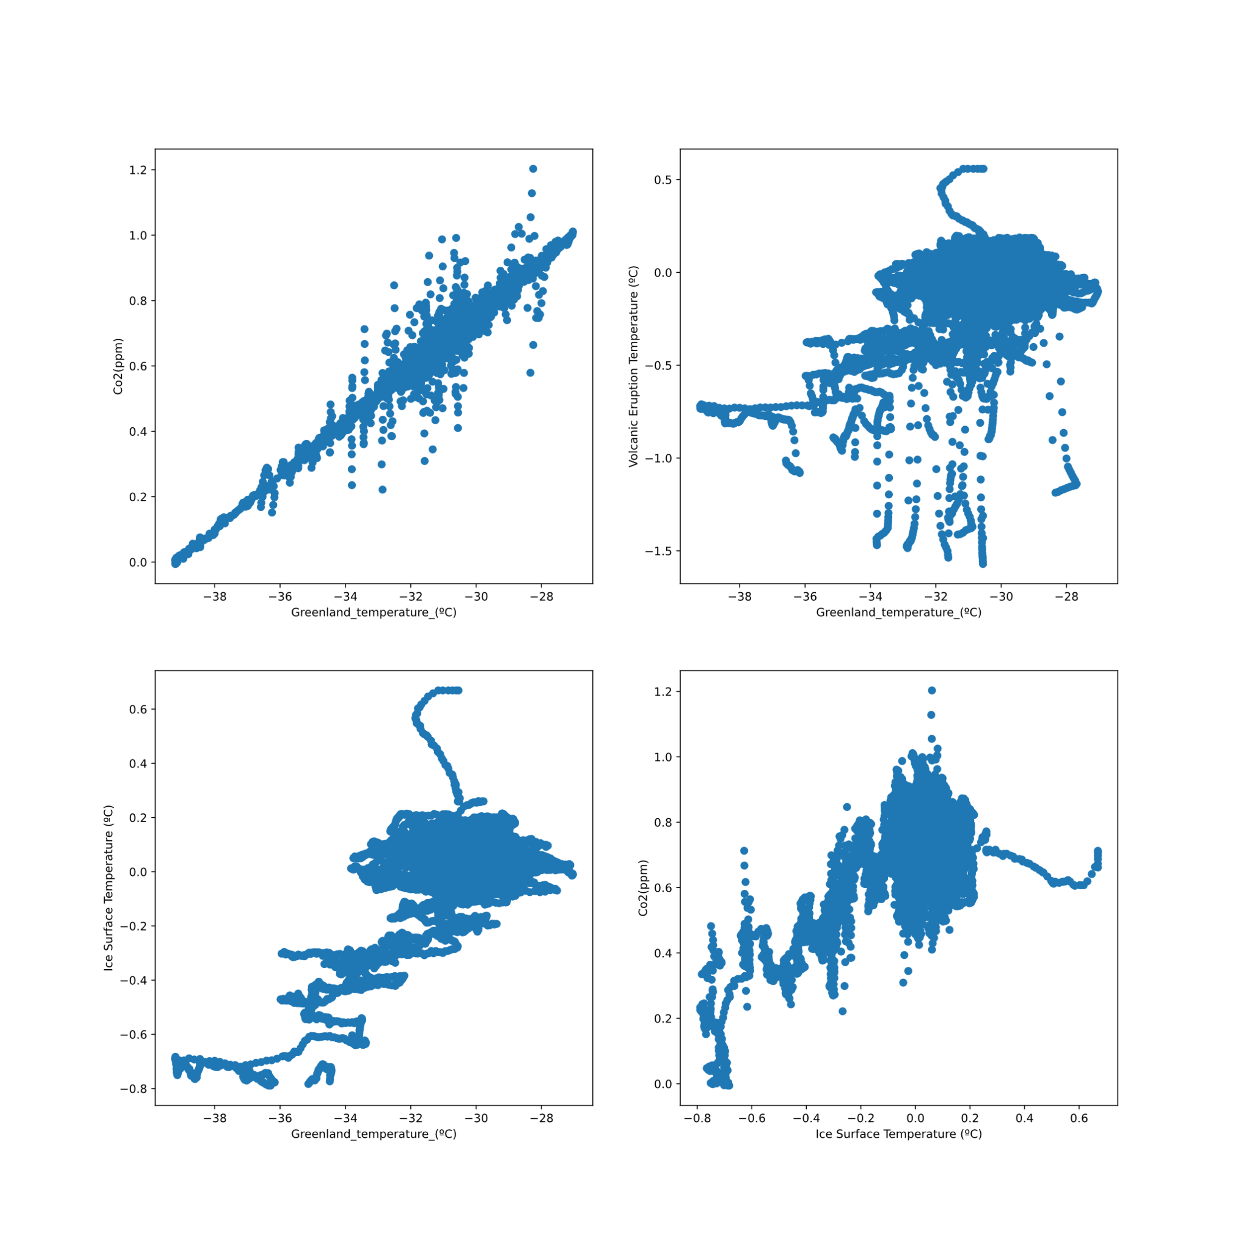
Scatter plot
Scatter plots show a positive correlation between variables, indicating a linear model is the best fit.

Slide 32
Preprocessing with MinMax Scaling
In this case, we have preprocessed the dataset using MinMax scaling before fitting models. MinMax scaling is a common method used to normalize the range of numeric characteristics to a certain range, typically between 0 and 1. This transformation ensures that all features have the same scale, preventing any one feature from dominating the model's learning process.

Slide 33
Split the dataset
I split the data into train data, which made up 80% of the whole set, and test data, which made up 20% of the whole set. Where train data has 9244 rows and 4 columns and test data have 2312 rows and 4 columns.
Size of the data that has been split
X_train : (9244, 3)
X_test : (2312, 3)
y_train: (9244, 1)
y_test: (2312, 1)

Slide 34
Simple Linear Regression model
Intercept: -0.1
Coefficients are :
Volcanic Eruption Temperature (°C) : -0.09
Ice Surface Temperature (°C): 0.08
Co2(ppm) : 1.24
R-squared: 0.75
Root Mean Square Error: 0.1
So, this simple linear regression model makes very good predictions. We try to see if we can make better predictions.

Slide 35
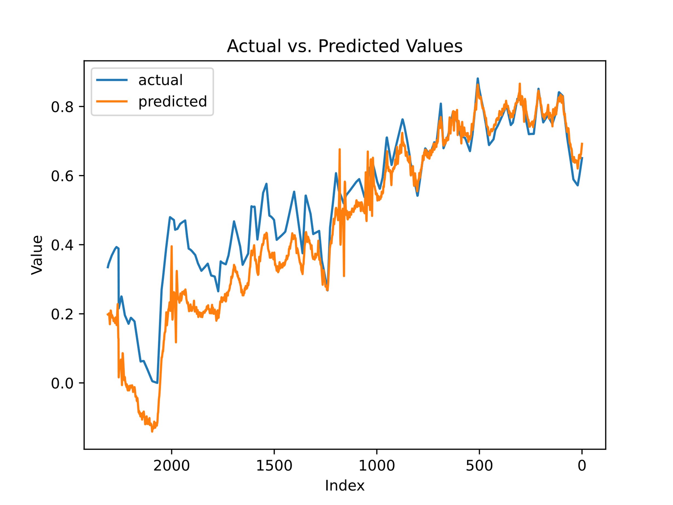
Graph of Actual vs. Predicted

Slide 36
Passive Aggressive Regression Model
The Passive Aggressive Regression model is useful for large datasets and scenarios where the data distribution may change. It is efficient and converges quickly, making it suitable for real-time applications or limited computational resources. The Passive Aggressive Regression Model will update the coefficient of the linear model to get a good prediction.
Here is the final model after passive-aggressive regression model fitting:
R-squared: 0.94
Root Mean Square Error: 0.05

Slide 37
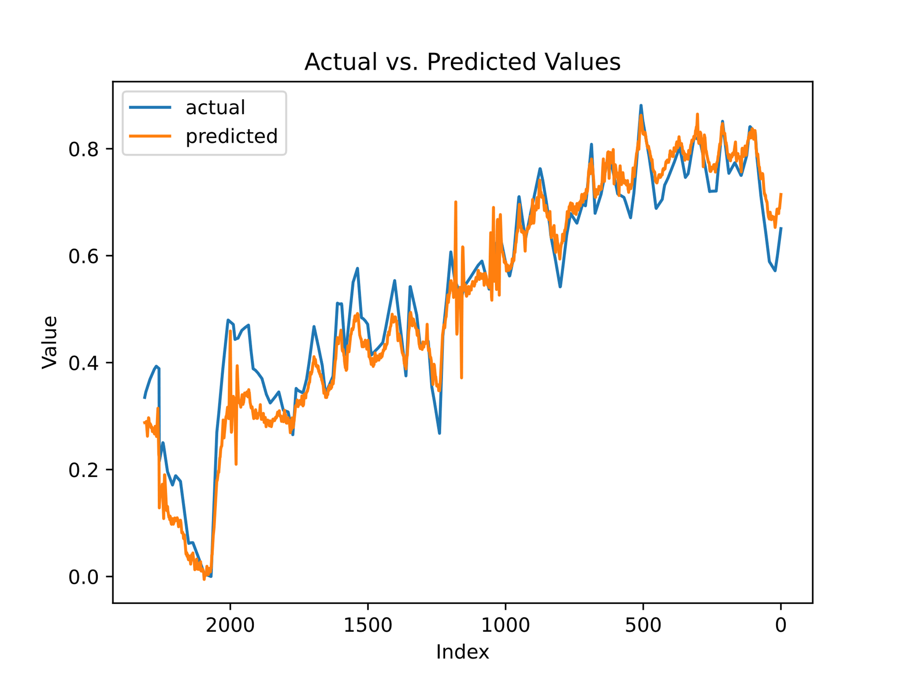
Graph of Actual vs. Predicted

Slide 38
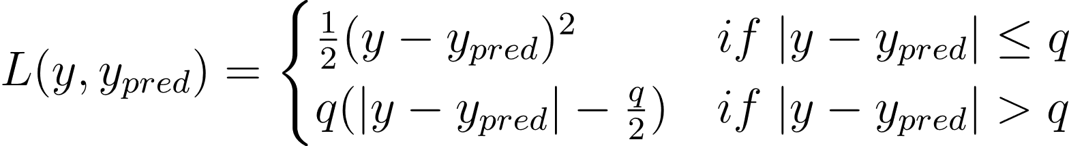
Huber Regression Model
The Huber regression model is a robust regression technique that assigns less weight to outliers, allowing for a more robust estimation of regression parameters.
Huber Loss Function :
The Huber loss function handles outliers by minimizing the sum of the Huber loss function across all data points. The threshold parameter q choice determines the trade-off between robustness and efficiency, with larger q values making the model more robust to outliers but less efficient for non-outlying data points.
Here is the final model after the Huber Regression model fitting with q=1:
R-squared: 0.96
Root Mean Square Error: 0.04

Slide 39

Graph of Actual vs. Predicted

Slide 40
Conclusion:
In our attempt to backcast temperature using univariate models and methods, we have not achieved the desired level of accuracy and faced challenges with long-term prediction. To improve results, we added expensive factors, transformed our data into a multivariate format, and utilized a linear model for backcasting. This approach yielded satisfactory outcomes in comparison. However, we should explore alternative approaches instead of relying on these methods. With more time, a more comprehensive investigation could be conducted to explore other analysis options and potentially achieve greater success.

